Slide 1
Final Report Presentation
Motor Vehicle Collisions in Toronto Arpandeep Singh : 040950261
Param Savalia : 040963842

Slide 2
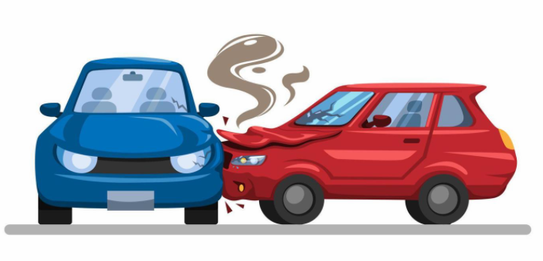
Data Collection
The data set has been obtained from Toronto Open Data. Its is open data initiative by the City of Toronto which provides royalty free data sets.
This dataset includes all traffic collisions events where a person was either Killed or Seriously Injured (KSI) from 2006 – 2020.
Link to the dataset: https://open.toronto.ca/dataset/motor-vehicle-collisions-involving-killed-or-seriously-injured-persons/

Slide 3
Question
What is the type of accident in Toronto and East York District with respect to the time of the day, age and road class ?

Slide 4
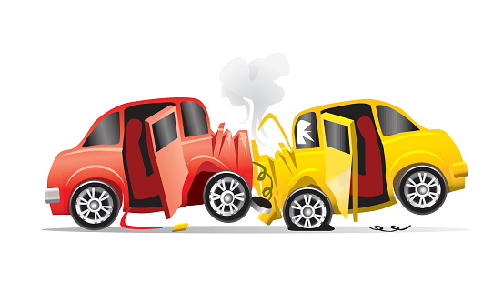

Introduction of the Dataset
This dataset includes all traffic collisions events where a person was either Killed or Seriously Injured (KSI) from 2006 – 2020. The location of crime occurrences have been deliberately offset to the nearest road intersection node to protect the privacy of parties involved in the occurrence. Due to the offset of occurrence location, the numbers by Division and Neighbourhood may not reflect the exact count of occurrences reported within these geographies. Therefore, the Toronto Police Service does not guarantee the accuracy, completeness, timeliness of the data and it should not be compared to any other source of crime data.
The dataset has over 16k+ records with 54 attributes.

Slide 5

Initial Guess
As a guess to our own question, we believe that Toronto and East York District will have more Fatal Accidents than Non - Fatal accidents. Also, as per our assumption, more collisions should occur at Night Time.
We also assume that youngsters or youth would be more involved in collisions as compared to other age groups.

Slide 6
First Impression of the Dataset
There is a lot of missing information.
Data Set is huge with over 16K records and over 54 Attributes
Useless Attributes.
Some of the columns need to changed before we can use.

Slide 7
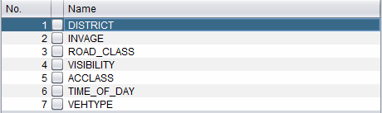
Data Preprocessing
Data Cleaning: Some of the attributes that we felt were redundant have been removed.
ACCLOC, ACCNUm, AG_DRIV, ALCOHOL, AUTOMOBILE CYCACT, CYCCOND, CYCLIST, CYCLIST TYPE, DATE, DISABILITY, DIVISION, DRIVACT, DRIVCOND, EMERG_VEH, FATAL_NO, HOOD_ID, IMPACTYPE, INITDIR, INVTYPE, LOCCOORD, MANOEUVER, MOTORCYCLE, NEIGHBOURHOOD, OFFSET, PASSENGER, PEDACT, PEDCOND, PEDESTRIAN, PEDTYPE, POLICE_DIVISION, RDSFCOND, REDLIGHT, SPEEDING, STREET1, STREET2, TRAFFCTL, TRSN_CITY_VEH , VEH TYPE, WARDNUM, YEAR, GEOMETRY were deleted because of lot of anomalies and missing data.
Final Attributes

Slide 8
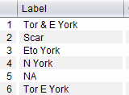
Data Modification
District names have been shortened for better readability.
Age ranges have been grouped together into age groups of Child, Adolescent, Youth, Adult and Senior.
0 to 4, 5 to 9 | Child
10 to 14, 15 to 19 | Adolescent
20 to 24, 25 to 29 | Youth
30 to 34 … 60 to 64 | Adult
>65 | Senior
(Blanks) | NA

Slide 9
Data Modification (contd.)
4. Hour column is converted to time of the day (Morning/Afternoon/Evening/Night) 5 am - 12pm -> Morning
12 pm - 17 pm -> Afternoon
17 pm -22pm → Evening
22 pm - 5 am → Night
5. For the Road_Class, similar road types have been put together into single road class. For example
Major Arterial, Major Arterial Ramp and Minor Arterial —> Arterial
Expressway and Expressway Ramp → Expressway
6. Missing blanks are replaced with NA implying Not Available,
7. No duplicates found!

Slide 10
Data Analysis
We analyzed the data in visualize tab and using classification methods in accordance to different attributes in dataset. Then we compare all the results with one attribute to get the results. After comparing results, we find that most impact on results are of attributes Time of the day, Age ,District.

Slide 11
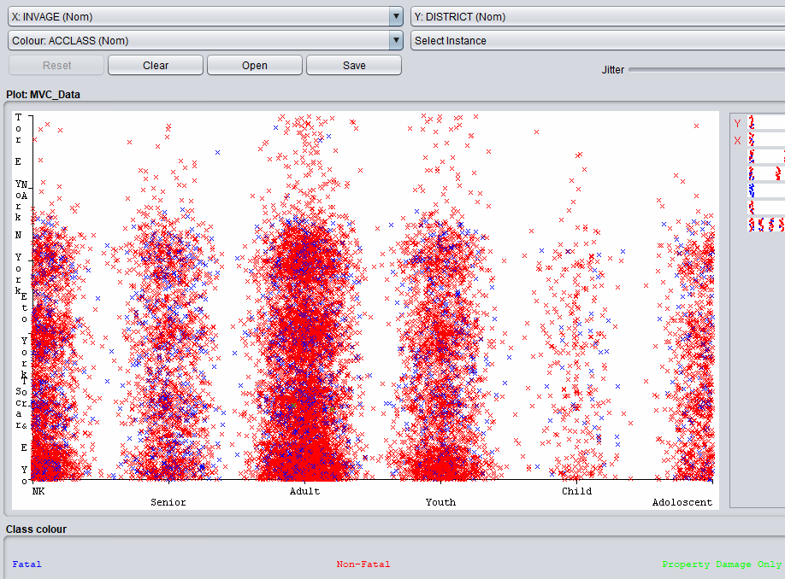
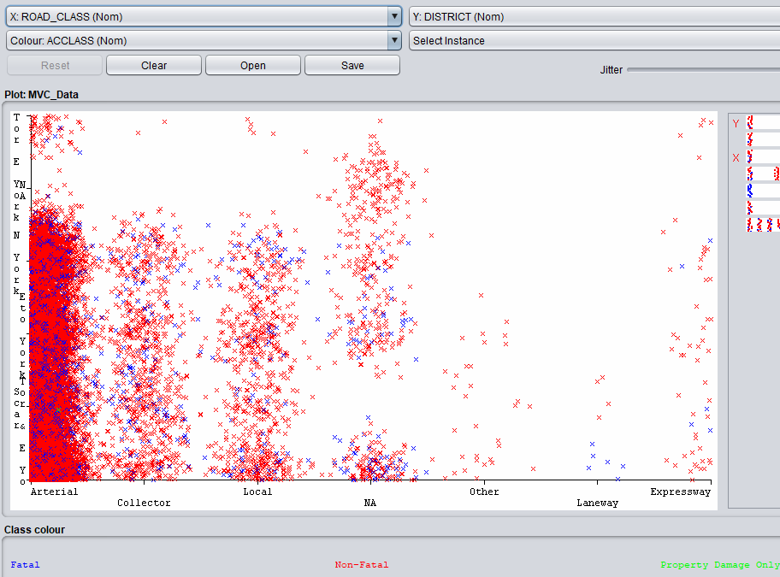
Interesting Graphs
Age vs District
Time of the day vs District

Slide 12
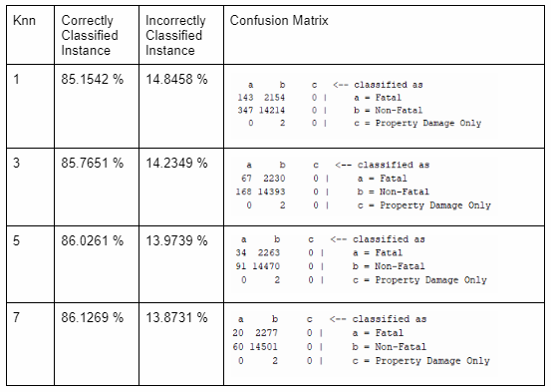
Algorithms
Classification by KNN
Most used classified algorithm.
-Uses different values for K
-How is the distance between points calculated ? Euclidean Distance :
-d= √[(x2-x1)^2+〖(y2-y1)〗^2]
-Accuracy is almost same for different values.
-Classifies class “a”, “b” and “c”.
K=7 is the best K in terms of accuracy.

Slide 13
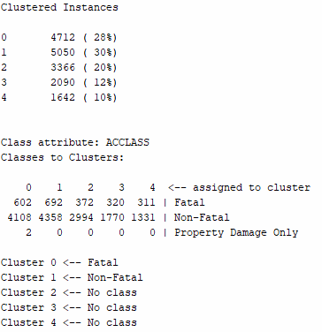
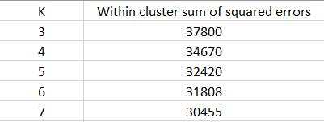
Algorithm
Clustering with SimpleKMeans Performed with K=3,4,5,6,7

Slide 14
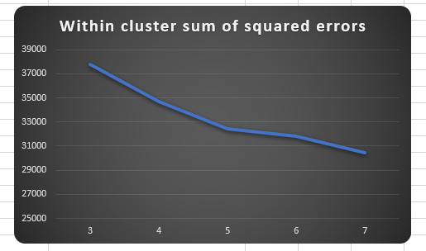
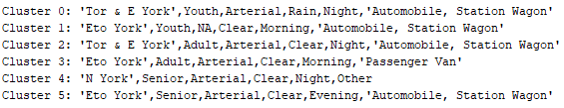
Algorithm
Clustering with SimpleKMeans (contd.)
Based on the Elbow point method, K=5 is the best K

Slide 15
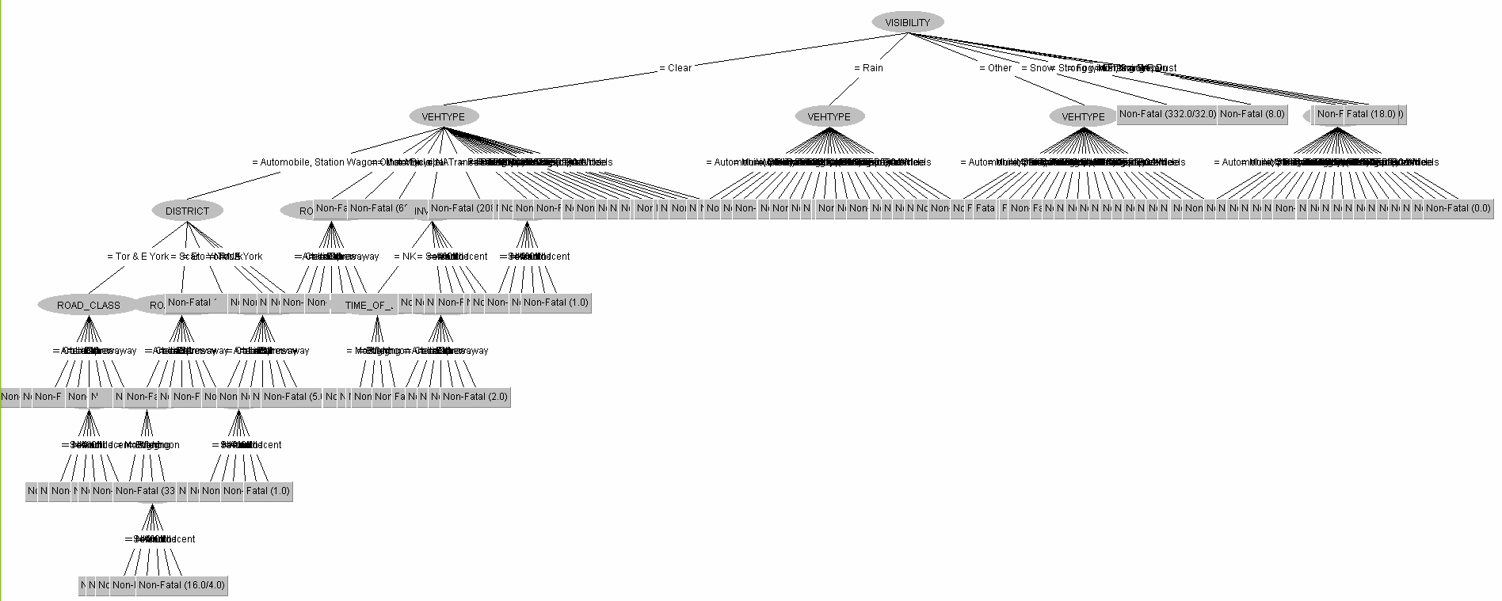
Algorithm
Binary Trees
Better readability by humans
Constructed using tweaking the default parameters of Weka
Confidence factor → 25% (0.25)
Unpruned → True
Each leaf of the tree represents the outcome of the decisions (Fatal/Non-Fatal)

Slide 16
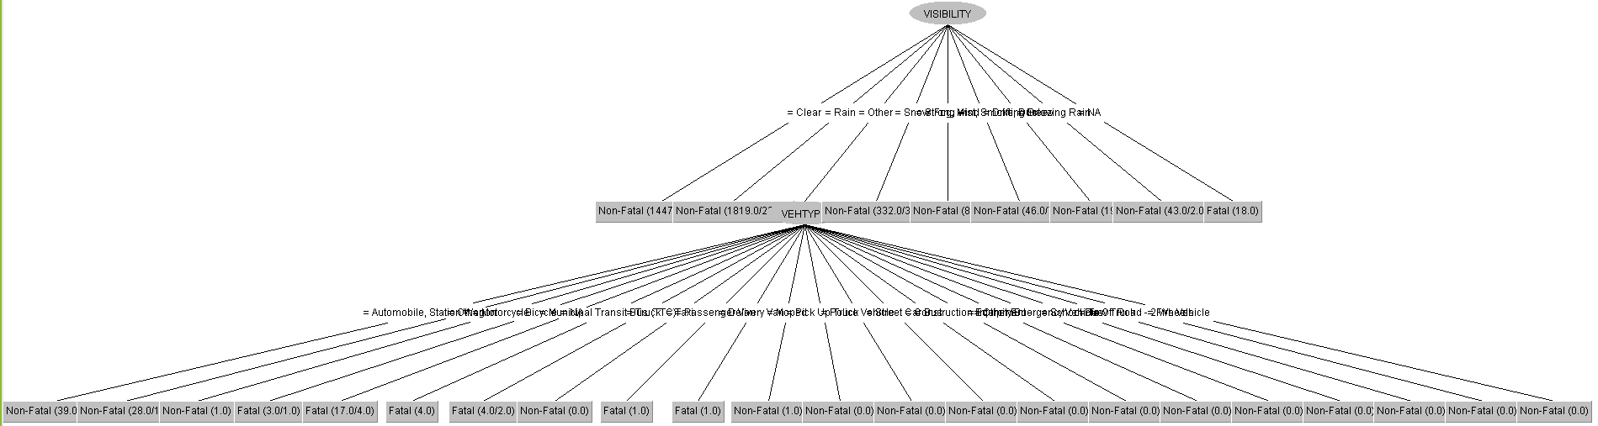
Binary Trees (contd.)
Parameters : “Unpruned: False, confidence factor: 0.15 (15%), minNumObj: 25”
-Confidence Factor, is used for better pruning the tree, the lower the confidence factor, higher the pruning.
-minNumObj refers to the minimum number of instances per leaf.
- Easily interpretable, the depth of the tree is reduced.
-The number of leaves were significantly reduced from 159 to 30
-Improved the accuracy by ~0.5%.

Slide 17
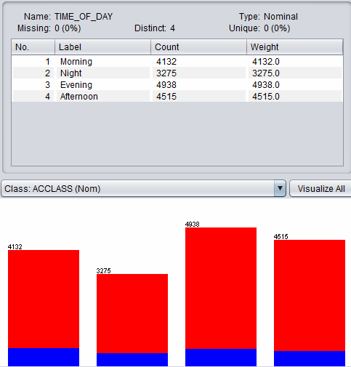
Results
Visual Representation of Time of day shows that most of the collisions occurred during Evening. However the numbers for Morning and Afternoon are significantly similar while least collisions occurred at Night time.

Slide 18
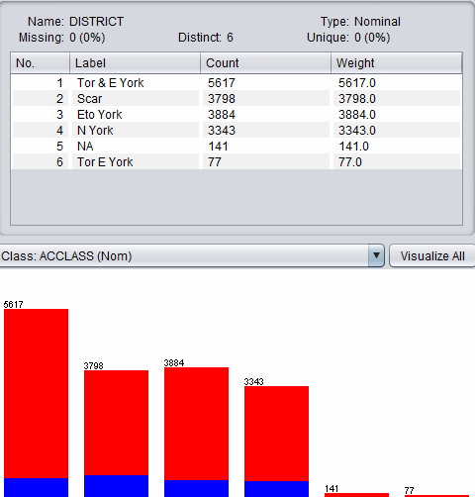
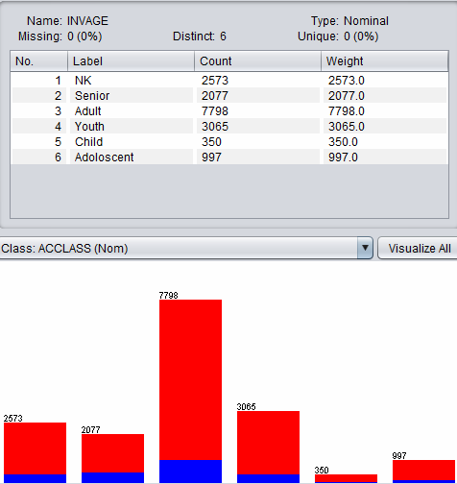
Results
Visual Representation of District shows that most of the non-fatal accidents occured in Toronto and East York. In fact Fatal accidents are significantly lower that Non- Fatal in all the cities
Visual Representation of INVAGE (Age of Involved Party) depicts that in most of the non-fatal collisions , Adults (Age 30 -64) were the one that more mostly involved followed by Youth and then Seniors.

Slide 19

Conclusion
Algorithm Results:
KNN Accuracy : 85.7 %
Decision Tree Accuracy : 86.34%
Despite the little higher accuracy of Decision tree , the algorithm misclassified almost all instances of ‘fatal’ class.
One of the reason of misclassification → 86% (14561/16860) of the attributes belonged to ‘Non-Fatal’ class.

Slide 20
References
https://open.toronto.ca/dataset/motor-vehicle-collisions-involving-killed-or-seriously-injured-persons/

